Slide 1


Introducing CSS

Slide 2

Open sublime Text
Setup
SSID: MakeShop
Password: workshops
www.webdev.therobotfoundry.net

Slide 3
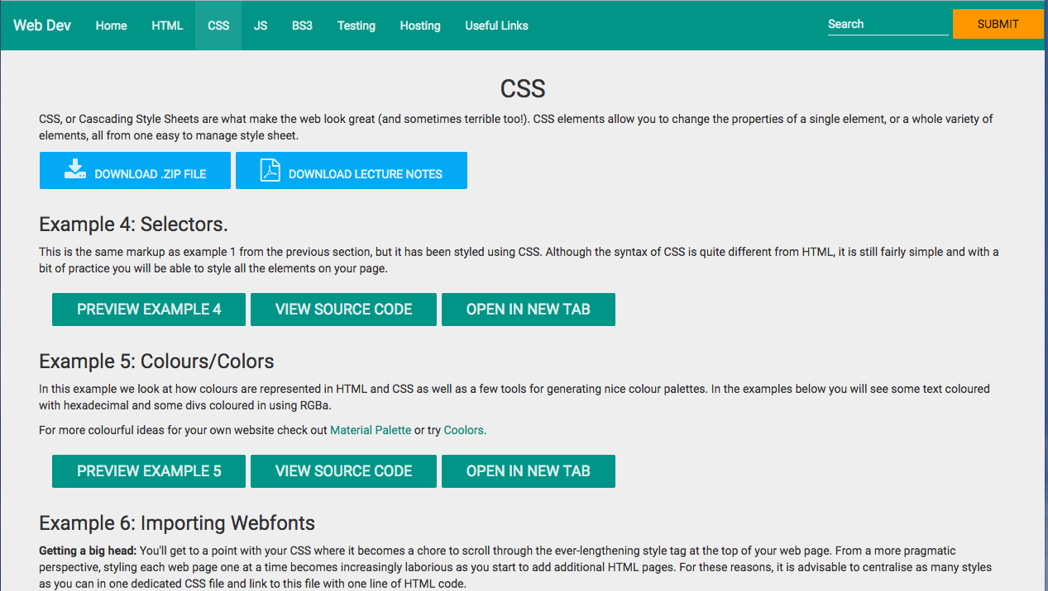

Slide 4
Introducing CSS

Slide 5
Course Overview
Presentation (HTML/CSS)
Interaction (Scripts/Databases)
Hosting

Slide 6

HyperText Markup Language
Structures a web document

Slide 7
Cascading Style Sheets
Gives style to the structure

Slide 8
Javascript
Versatile programming language

Slide 9
Objective
Add style to the structure from week 1.

Slide 10
Method
Four Challenges:
Style “history.html”
Create a Navigation Bar
Single Page site
Multi-page site

Slide 11
CSS
Cascading → Closest to the code wins
Style → Not a programming language
Sheet → Standalone .css file

Slide 12
example
Opening → selector{
Style → attribute : value;
Closing → }
Example → body{
background-color: gray;
}

Slide 13
Selectors
Styling elements by their tag names
html{
property: value;
}

Slide 14
Classes & IDs
Classes - Groups of similar components, begins with ‘.’
.myClass{
property: value;
}
IDs - Used for individual elements, begins with ‘#’
#myId{
property: value;
}

Slide 15
Adding Style
<style> tags
<link> tag
<head>
<style>
body{
background-color: green;
color: white
}
</style>
</head>
<head>
<link rel="stylesheet" href="textStyles.css” />
</head>

Slide 16
Colours
Hex and RGBa

Slide 17
Backgrounds
body{
background-color: #fff;
background-image: url("../images/green_grad_tiny.png");
background-repeat: repeat-y;
background-attachment: top;
/*background-position: top right*/
/*background-size: cover;*/
/*background-size: contain;*/
}

Slide 18
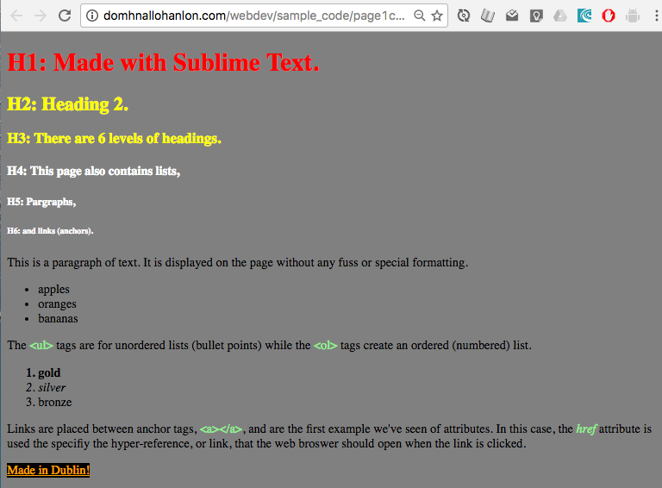
Challenge 1
X
Style your “history.html” document to change the colours of the background, headings, links, paragraphs and list items.
Add a background image.

Slide 19
Box Model
Margin
Border
Padding
Content

Slide 20
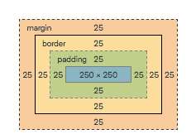
Box Model
div{
width: 250px;
height: 250px;
border: 25px solid green;
padding: 25px;
margin: 25px;
}

Slide 21
Positioning
div{
Position: relative
Display: block
Float: left
}

Slide 22
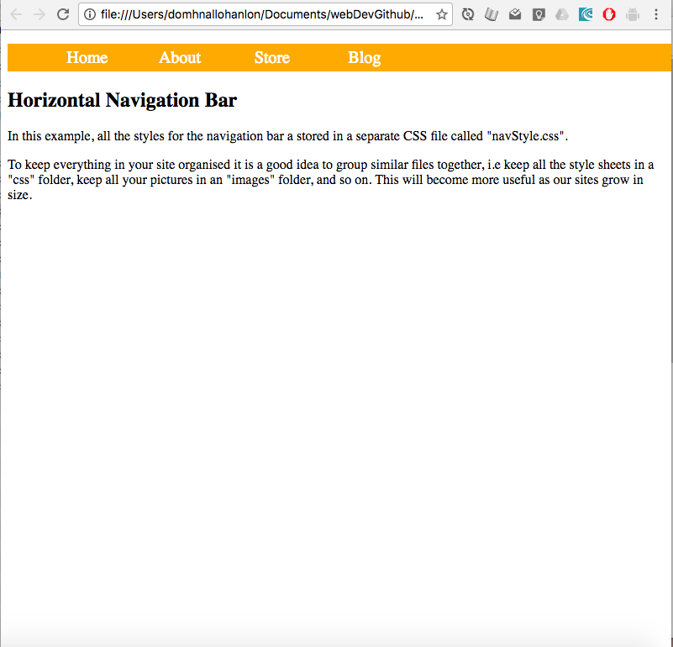
Challenge 2
X
Create a CSS menu.
Display
Float
Text-Decoration

Slide 23
Text Attributes
p{
text-align: center;
/*text-align: left;*/
/*text-align: right;*/
/*text-align: justify;*/
text-transform: uppercase;
/*text-transform: lowercase;*/
/*text-transform: capitalize;*/
}

Slide 24
Text Attributes
p{
text-align: center;
text-transform: uppercase;
text-indent: 50px;
/*text-indent: 3em;*/
line-height: 1.2;
}

Slide 25
Font Attributes
p{
font-size: 20px;
font-weight: bold;
font-style: italic;
font-variant: small-caps;
font-family: 'Arial', sans-serif;
}

Slide 26
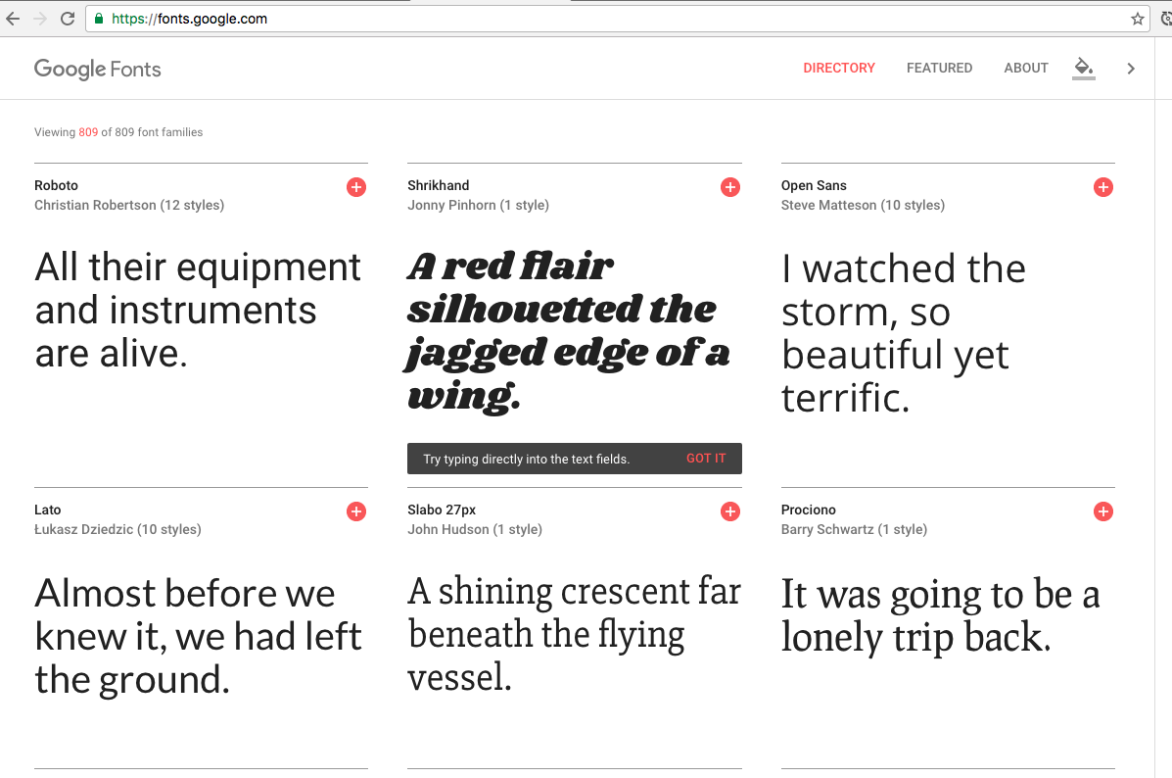
Google Fonts
Google Fonts

Slide 27
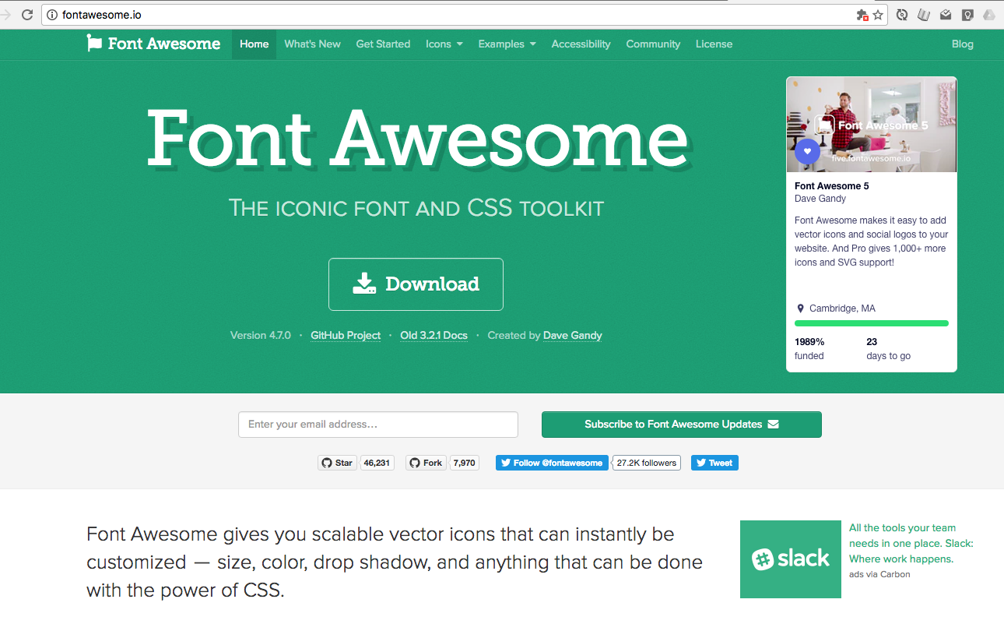
Font Awesome
Font Awesome

Slide 28
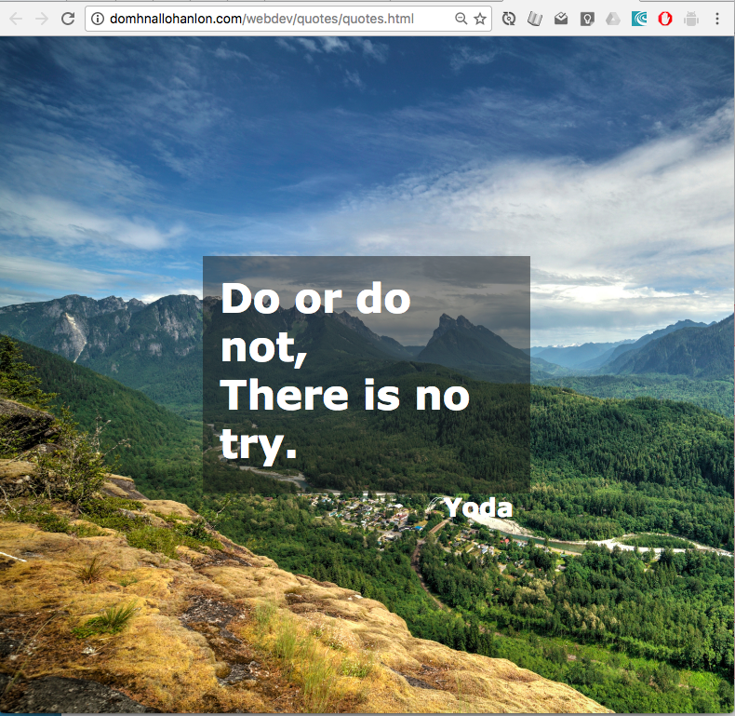
Challenge 3
X
Full screen, inspirational quotes.
Transparent DIVs

Slide 29
Pseudo Selectors
a{
background-color: black;
color: yellow;
text-decoration: none;
/*text-decoration: underline;*/
/*text-decoration: overline;*/
/*text-decoration: line-through;*/
}
a:hover{
background-color: yellow;
color: black;
/*text-decoration: none;*/
text-decoration: underline;
/*text-decoration: overline;*/
/*text-decoration: line-through;*/
}
Notes:
See also :before and :after

Slide 30
Sizing
Pixels
EMs

Slide 31
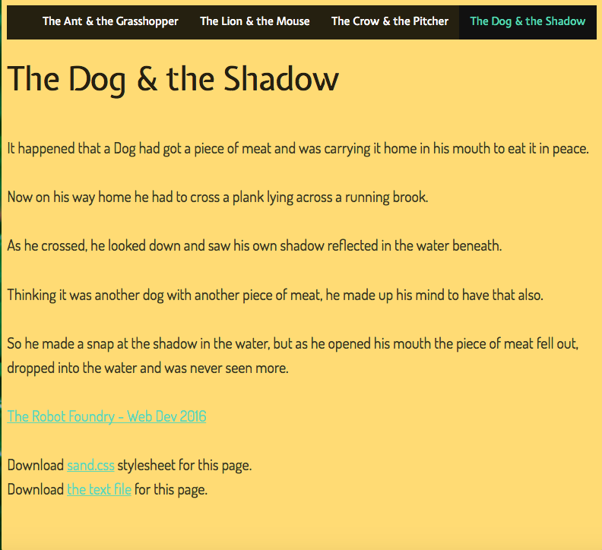
Challenge 4
X
Fully styled site.
Navigation Bar.
Web Fonts.

Slide 32
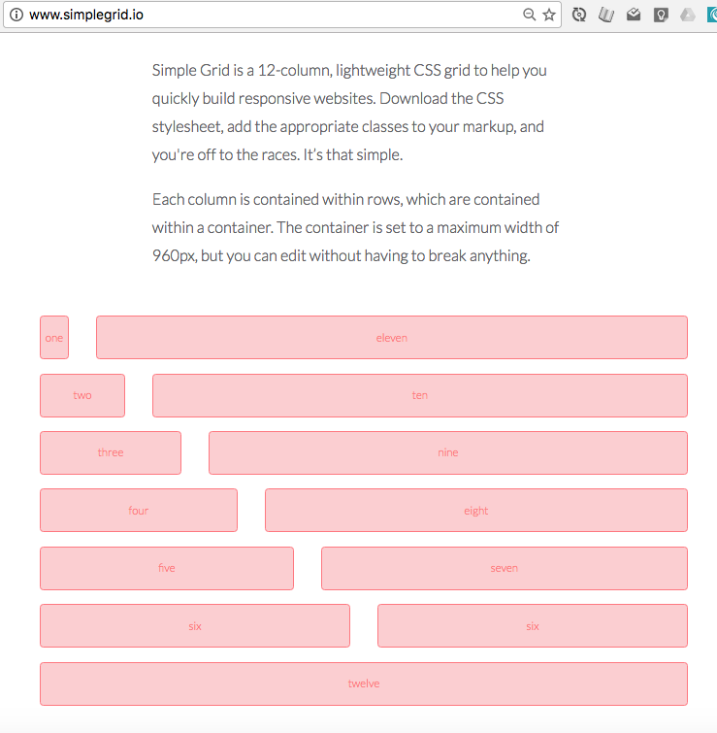
Grid Systems
X
Bootstrap
960
SimpleGrid

Slide 33
Demos
X

